Slide 1
UTA024
Fundamental of Arduino
Dr. Ashutosh Mishra
CSED https://sites.google.com/thapar.edu/buggy/home

Slide 2
Course Introduction
Course Name: Engineering Design - II (Buggy)
Course ID: UTA024
Credit: 3.0
Evaluation Criteria:
Quiz
Lab Evaluation (LE1, LE2 and LE3)
Demonstration of Three different Challenges (Bronze, Silver and Gold)

Slide 3
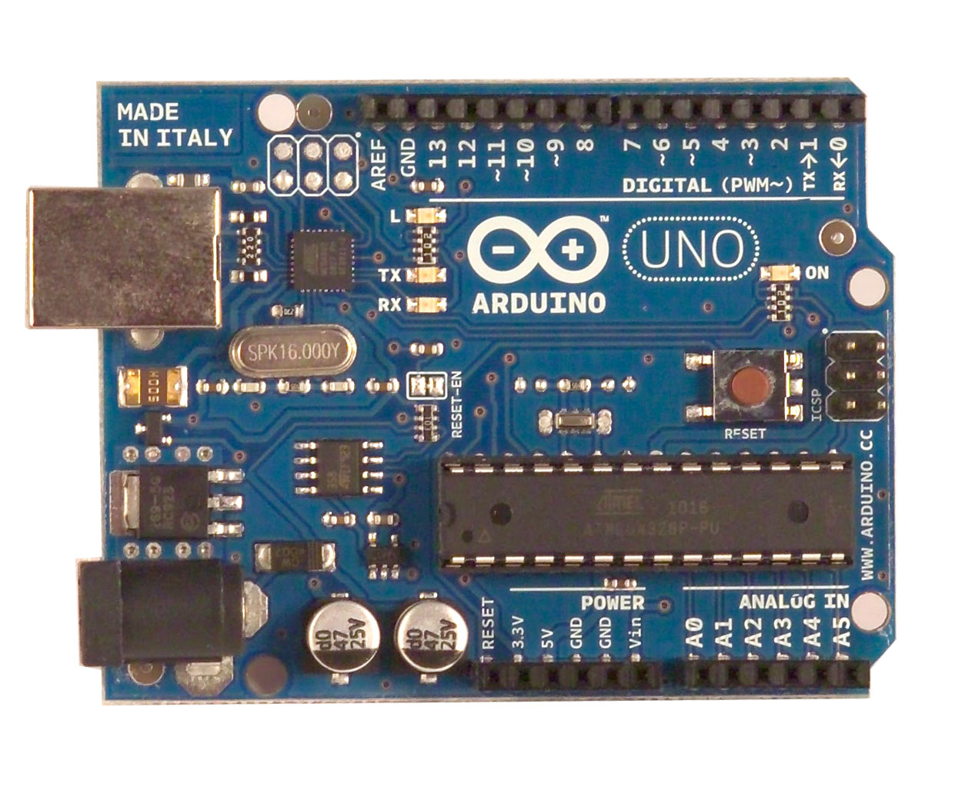
What is an Arduino ?
Open Source electronic prototyping platform based on flexible easy to use hardware and software.

Slide 4
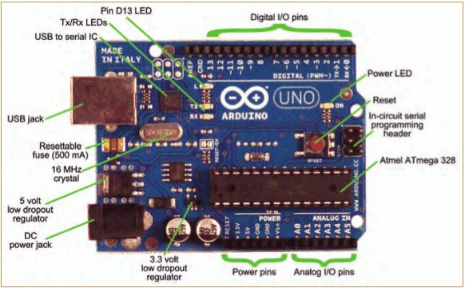
The Arduino Development Board
Making-robots-with-arduino.pdf

Slide 5
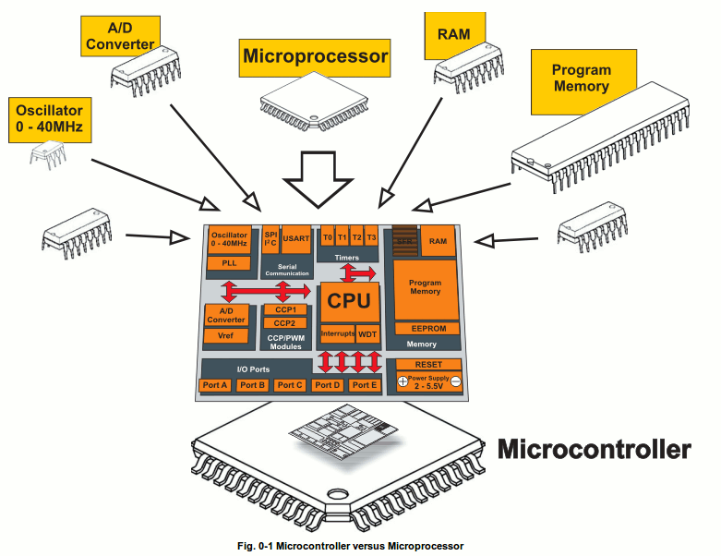
What is a Microcontroller
www.mikroe.com/chapters/view/1
A small computer on a single chip
  containing a processor, memory, and input/output
Typically "embedded" inside some device that they control
A microcontroller is often small and low cost

Slide 6
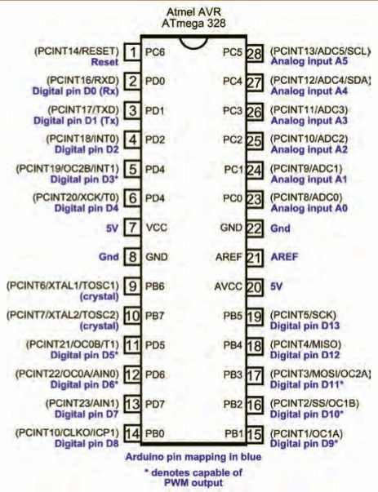
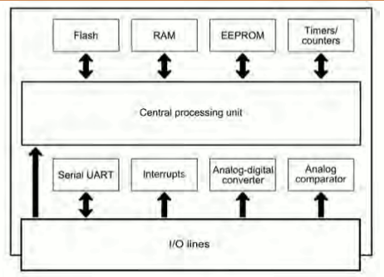
The Arduino Microcontroller: Atmel Atmega 328p
Specification
Making-robots-with-arduino.pdf

Slide 7
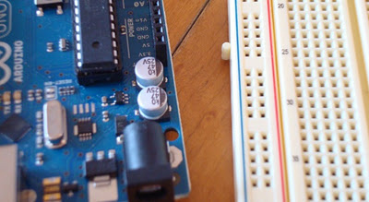
What is a Development Board
A printed circuit board designed to facilitate work with a particular microcontroller.
Typical components include:
  power circuit
  programming interface
  basic input; usually buttons and LEDs
  I/O pins

Slide 8
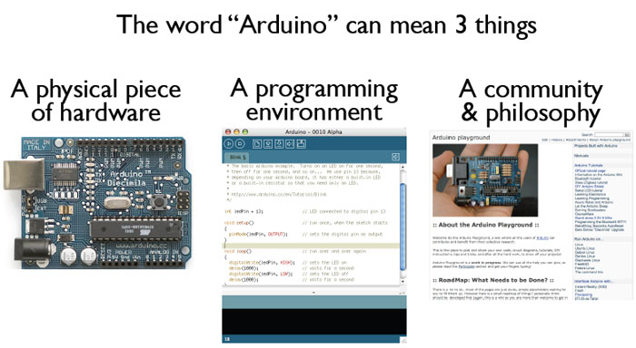
What is the Arduino
todbot.com/blog/bionicarduino

Slide 9
Getting Started
Check out: http://arduino.cc/en/Guide/HomePage
  Download & install the Arduino environment (IDE)
  Connect the board to your computer via the UBS cable
  If needed, install the drivers
  Launch the Arduino IDE
  Select your board
  Select your serial port
  Open the program code
  Upload the program

Slide 10
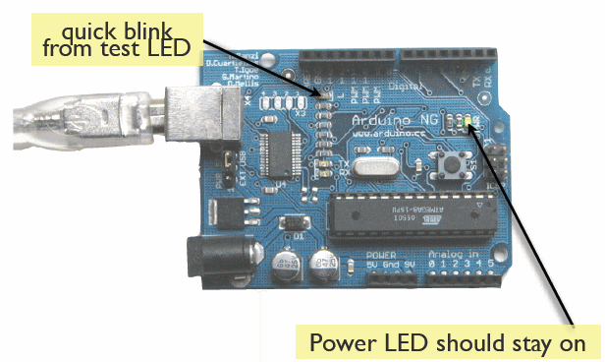
Try It: Connect the USB Cable
todbot.com/blog/bionicarduino

Slide 11
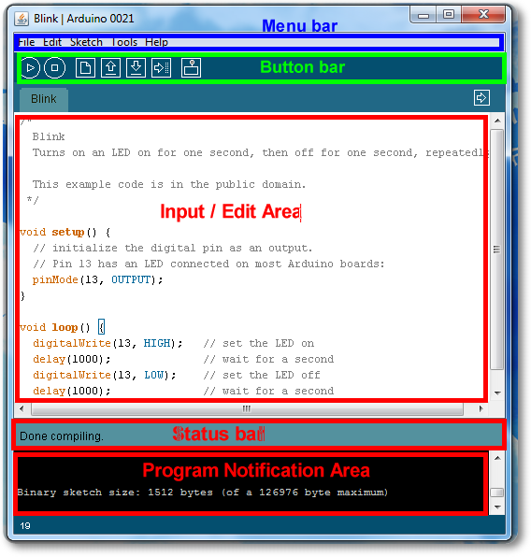
Arduino IDE
See: http://arduino.cc/en/Guide/Environment for more information

Slide 12
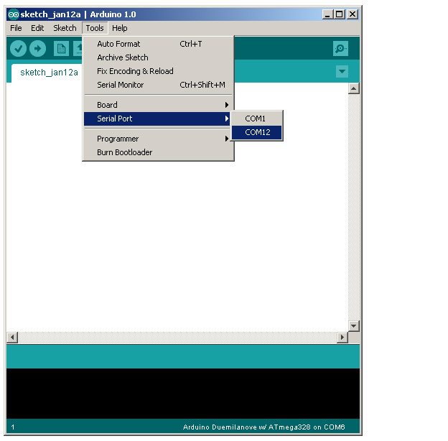
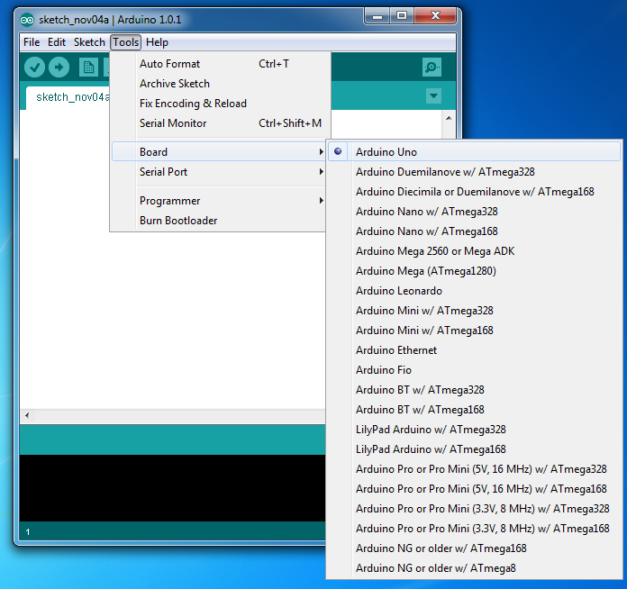
Select Serial Port and Board

Slide 13
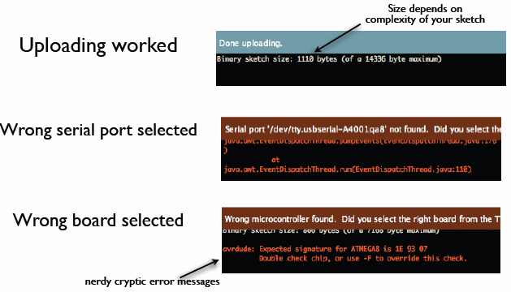
Status Messages
todbot.com/blog/bionicarduino

Slide 14
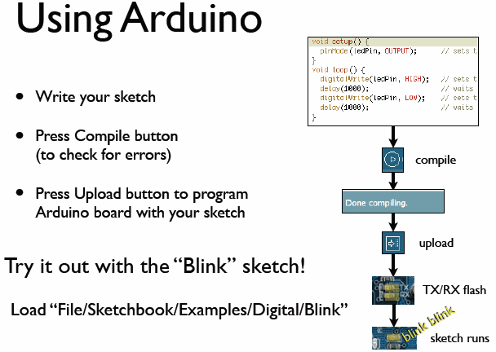
todbot.com/blog/bionicarduino

Slide 15
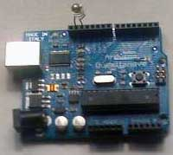
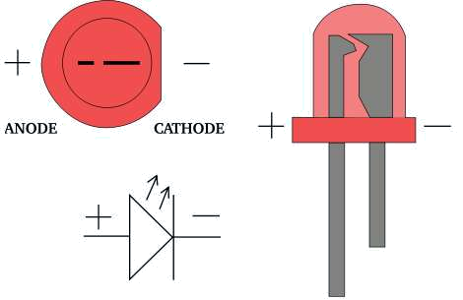
Add an External LED to pin 13
File > Examples > Digital > Blink
LED’s have polarity
  Negative indicated by flat side of the housing and a short leg
www.instructables.com

Slide 16
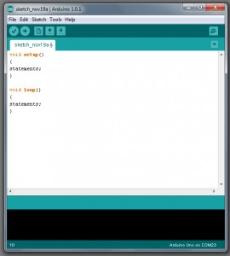
A Little Bit About Programming
Code is case sensitive
Statements are commands and must end with a semi-colon
Comments follow a // or begin with /* and end with */
loop and setup

Slide 17
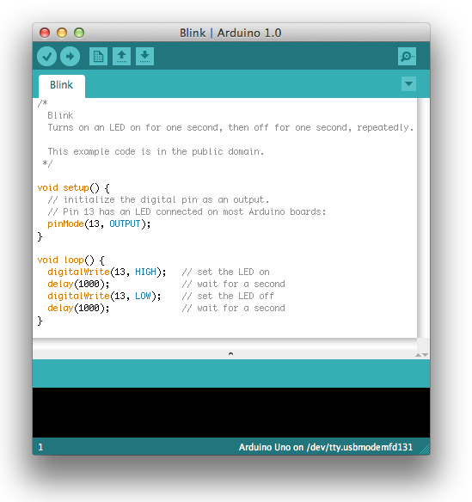
Our First Program

Slide 18
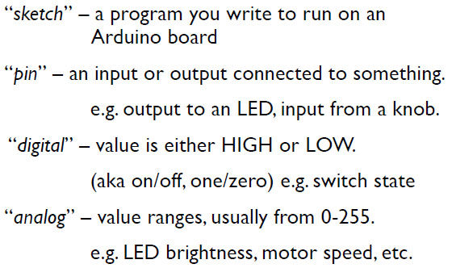
Terminology

Slide 19
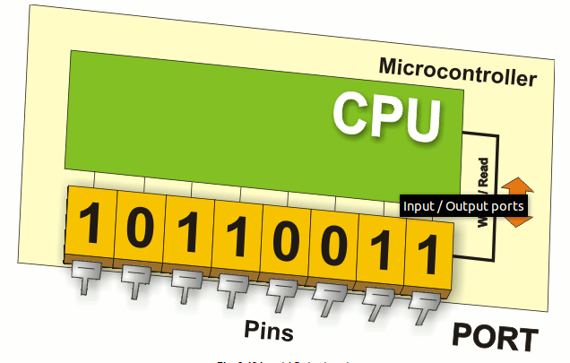
Digital I/0
www.mikroe.com/chapters/view/1
pinMode(pin, mode)
  Sets pin to either INPUT or OUTPUT
digitalRead(pin)
  Reads HIGH or LOW from a pin
digitalWrite(pin, value)
  Writes HIGH or LOW to a pin

Slide 20
Arduino Timing
delay(ms)
  Pauses for a few milliseconds
delayMicroseconds(us)
  Pauses for a few microseconds

Slide 21
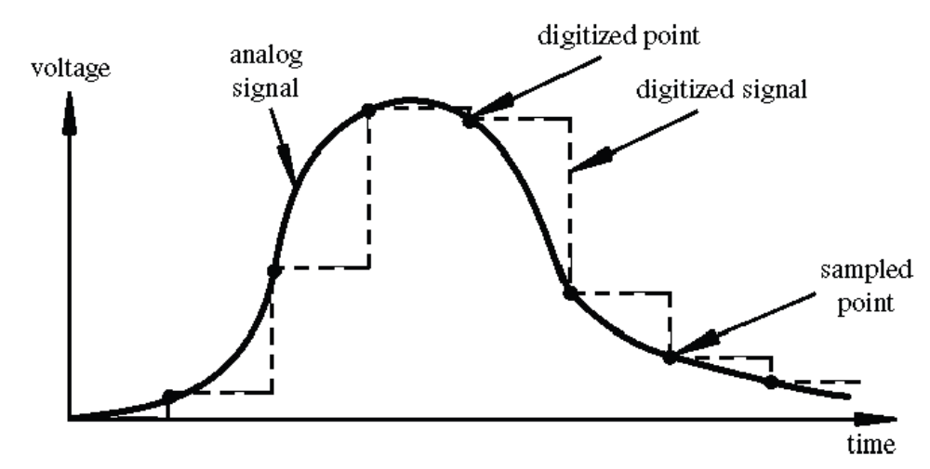
Digital? Analog?
Digital has two values: on and off
Analog has many (infinite) values
Computers don’t really do analog, they quantize
Remember the 6 analog input pins---here’s how they work
todbot.com/blog/bionicarduino

Slide 22
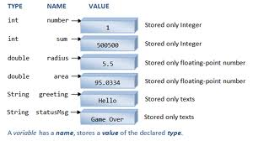
Variables

Slide 23
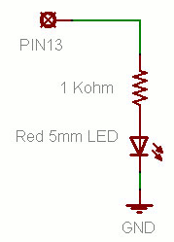
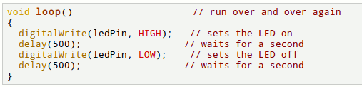
Putting It Together
Complete the sketch (program) below.
What output will be generated by this program?
What if the schematic were changed? ➔
www.ladyada.net/learn/arduino

Slide 24
Analog to Digital Coversion
What is analog ?
It is continuous range of voltage values (not just 0 or 5V)
Why convert to digital ?
Because our microcontroller only understands digital.

Slide 25
ADC in Arduino
The Arduino Uno board contains 6 pins for ADC
10-bit analog to digital converter
This means that it will map input voltages between 0 and 5 volts into integer values between 0 and 1023

Slide 26
Reading/Writing Analog Values
analogRead(A0); // used to read the analog value from the pin A0
analogWrite(2,128);

Slide 27
Serial Communications
Serial.begin(9600)
Serial.print()
Serial.println()
Serial.read()
Serial.write()

Slide 28
Input & Output
Transferring data from the computer to an Arduino is done using Serial Transmission
To setup Serial communication we use the following
void setup() {
Serial.begin(9600);
}

Slide 29
Writing to the Console
void setup() {
Serial.begin(9600);
Serial.println(“Hello World!”);
}
void loop() {}

Slide 30
Reading data from Arduino
void setup()
{
Serial.begin(9600);
}
void loop()
{
int i;
for(i=0; i<10; i++)
Serial.println(i);
}

Slide 31
Serial.read()
int incomingByte = 0; // for incoming serial data
void setup()
{
Serial.begin(9600); // opens serial port, sets data rate to 9600 bps
}
void loop() {
if (Serial.available() > 0) { // send data only when you receive data:
incomingByte = Serial.read(); // read the incoming byte:
Serial.print("I received: "); // say what you got:
Serial.println(incomingByte, DEC);
}
}

Slide 32
Serial.write()
Writes binary data to the serial port. This data is sent as a byte or series of bytes; to send the characters representing the digits of a number use the print() function instead.
void setup() {
Serial.begin(9600);
}
void loop() {
Serial.write(65); // send a byte with the value 65 int
int bytesSent = Serial.write("hello");
}
//send the string "hello" and return the length of the string.

Slide 33
Simulator
https://www.tinkercad.com/

Slide 34
Resources
http://www.tutorialspoint.com/arduino/
https://www.arduino.cc/en/Tutorial/HomePage
https://www.tutorialspoint.com/csharp/
http://www.completecsharptutorial.com/

Slide 35
Thanks

